Slide 1
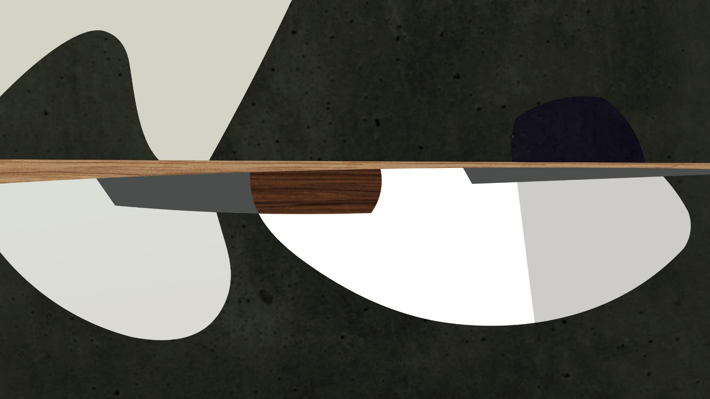
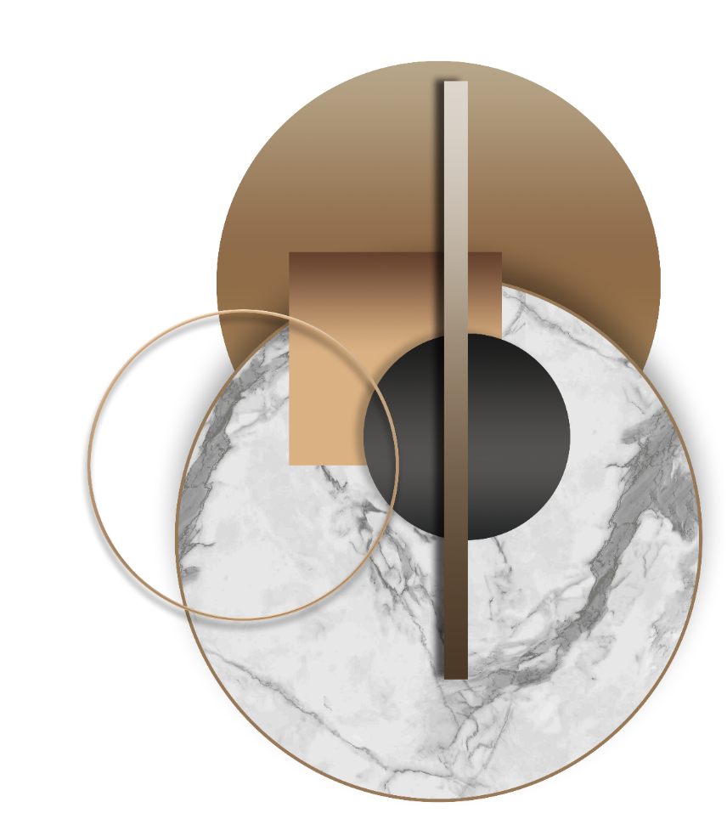
MORIMOTO
Fashion Template Design.

Slide 2
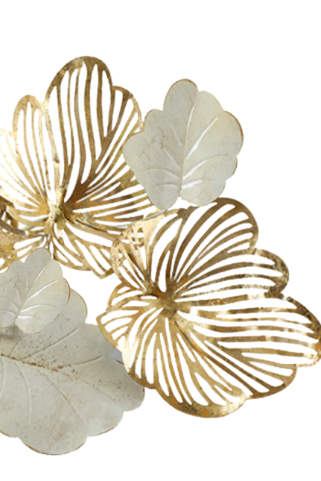
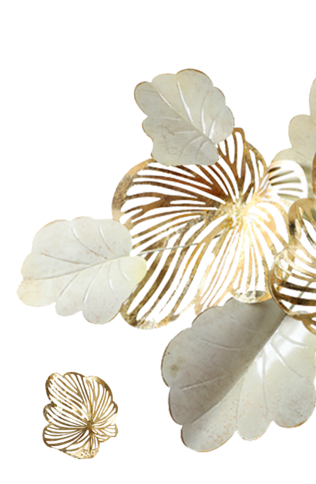
Contents
01.单击添加标题
04.单击添加标题
02.单击添加标题
05.单击添加标题
03.单击添加标题
06.单击添加标题

Slide 3



MORI.COM
Synergistically utilize technically sound portals with, Synergistically utilize technically sound, Synergistically utilize, Synergistically utilize technically sound portals with,
MORI.COM
Synergistically utilize technically sound portals with frictionless chainsSynergistically

Slide 4
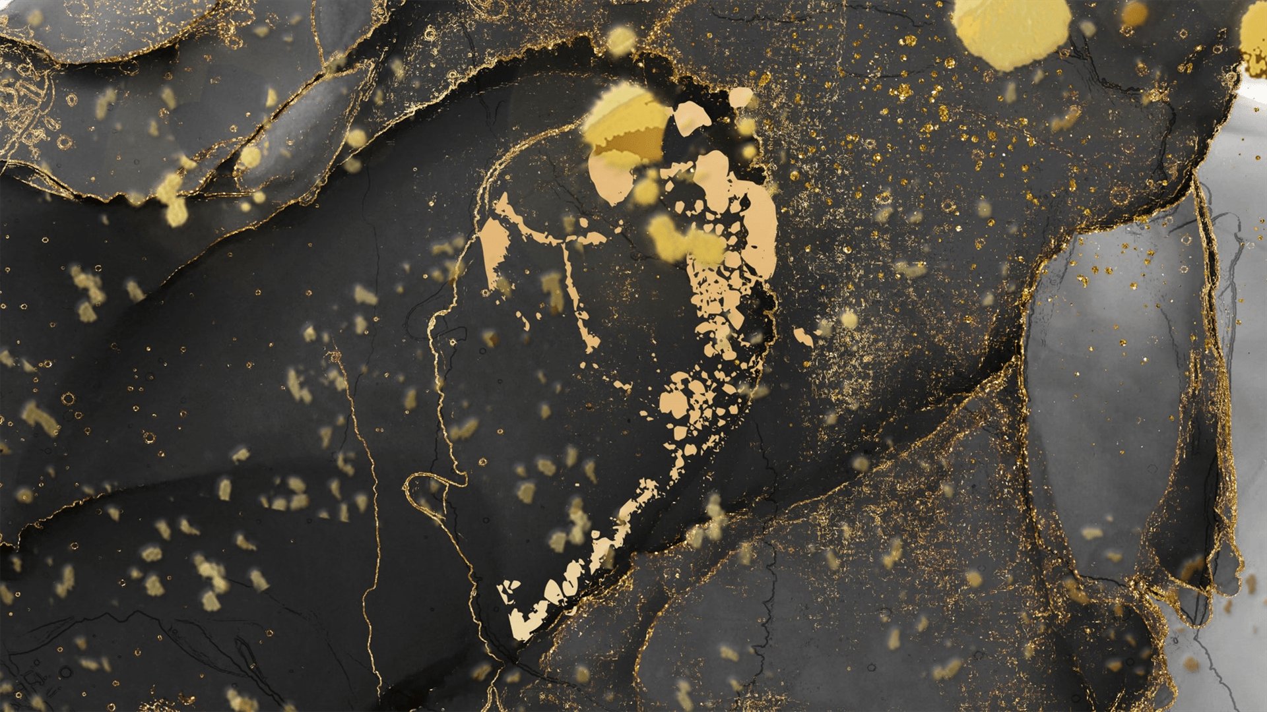
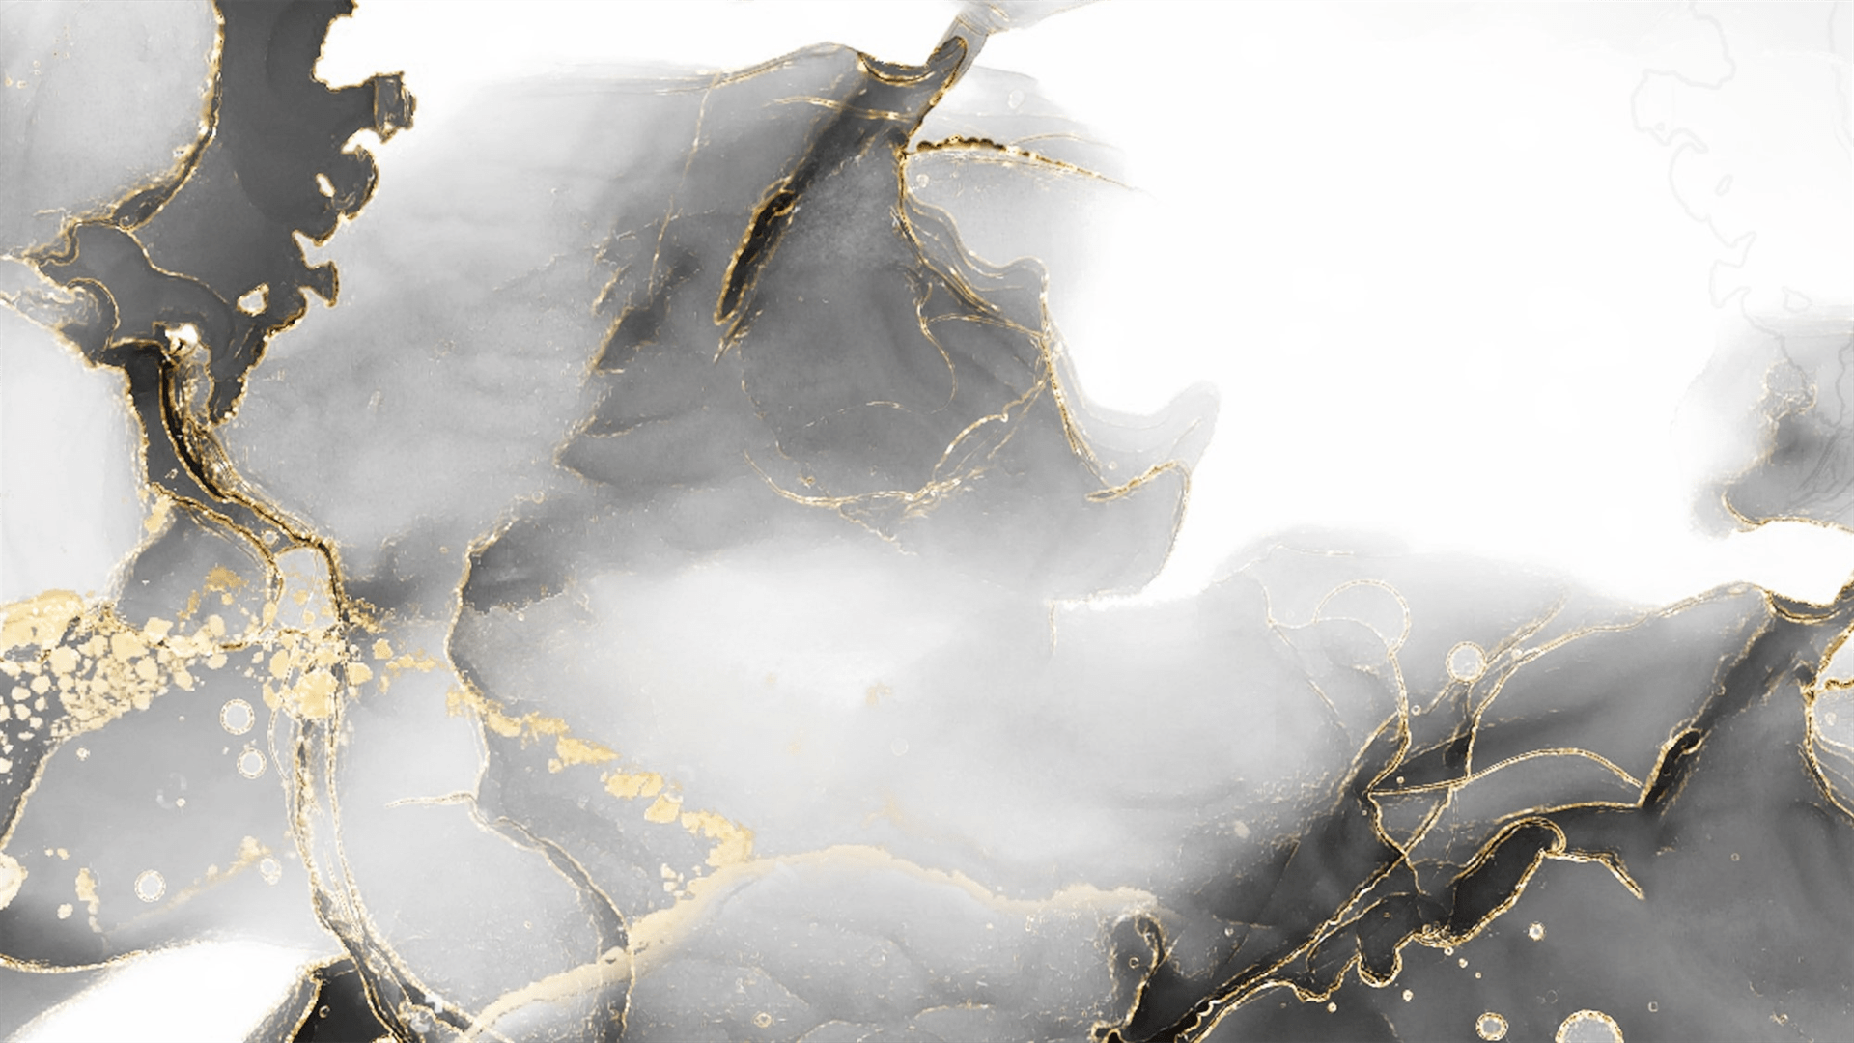
Synergistically utilize technically sound portals with, Synergistically utilize technically sound, , Synergistically utilize technically sound portals with, Synergistically utilize
Synergistically utilize technically sound portals with, Synergistically utilize technically sound, , Synergistically utilize technically sound portals with, Synergistically utilize
Synergistically utilize technically sound portals with, Synergistically utilize technically sound, , Synergistically utilize technically sound portals with, Synergistically utilize

Slide 5
MORI.COM
text styles
MORI.COM
0 1
Synergistically utilize technically sound portals with, Synergistically utilize technically sound,
0 2
Synergistically utilize technically sound portals with, Synergistically utilize technically sound,
0 3
Synergistically utilize technically sound portals with, Synergistically utilize technically sound,

Slide 6
MORI.COM
Synergistically utilize technically sound portals with, Synergistically utilize technically sound, , Synergistically utilize
Synergistically utilize technically sound portals with, Synergistically utilize technically sound, , Synergistically utilize
Synergistically utilize technically sound portals with, Synergistically utilize technically sound, , Synergistically utilize
Synergistically utilize technically sound portals with, Synergistically utilize technically sound, , Synergistically utilize
Synergistically utilize technically sound portals with, Synergistically utilize technically sound, , Synergistically utilize
Synergistically utilize technically sound portals with, Synergistically utilize technically sound, , Synergistically utilize

Slide 7

MORI.COM
Synergistically utilize technically sound portals with, Synergistically utilize technically sound, Synergistically utilize, Synergistically utilize technically sound portals with,
MORI.COM
Synergistically utilize technically sound portals with frictionless chainsSynergistically

Slide 8
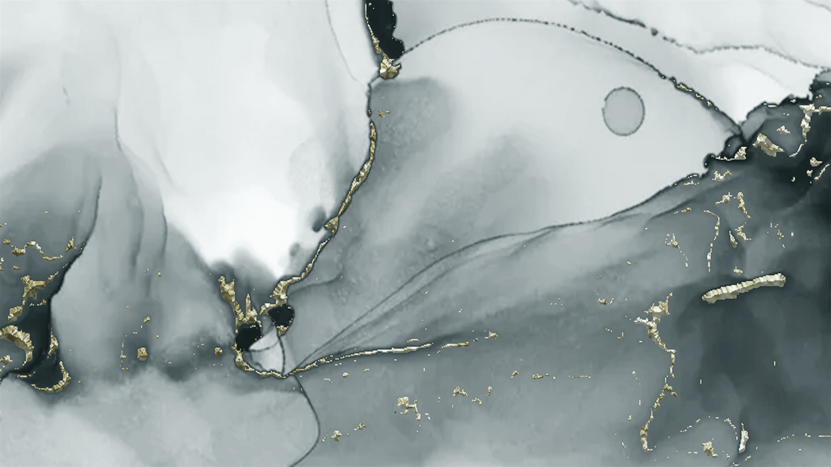
Synergistically utilize technically sound portals with, Synergistically utilize technically sound, , Synergistically utilize technically sound portals with, Synergistically utilize
MORI.COM
Synergistically utilize technically sound portals with, Synergistically utilize technically sound, , Synergistically utilize technically sound portals with, Synergistically utilize
MORI.COM

Slide 9
MORI.COM
01
Synergistically utilize technically sound portals with, Synergistically utilize technically sound, , Synergistically utilize
$150M
02
Synergistically utilize technically sound portals with, Synergistically utilize technically sound, , Synergistically utilize
$200M
03
Synergistically utilize technically sound portals with, Synergistically utilize technically sound, , Synergistically utilize
$15M

Slide 10
MORI.COM
Synergistically utilize technically sound portals with, Synergistically utilize technically sound, , Synergistically utilize technically sound portals with, Synergistically utilize

Slide 11

MORI.COM
Synergistically utilize technically sound portals with, Synergistically utilize technically sound, Synergistically utilize, Synergistically utilize technically sound portals with,
MORI.COM
Synergistically utilize technically sound portals with frictionless chainsSynergistically

Slide 12
MORI.COM
1
Synergistically utilize technically sound portals with, Synergistically utilize technically sound, , Synergistically utilize technically sound portals with, Synergistically utilize
2
Synergistically utilize technically sound portals with, Synergistically utilize technically sound, , Synergistically utilize technically sound portals with, Synergistically utilize
3
Synergistically utilize technically sound portals with, Synergistically utilize technically sound, , Synergistically utilize technically sound portals with, Synergistically utilize

Slide 13
MORI.COM
Synergistically utilize technically sound portals with, Synergistically utilize technically sound, , Synergistically utilize technically sound portals with, Synergistically utilize
Synergistically utilize technically sound portals with, Synergistically utilize technically sound, , Synergistically utilize technically sound portals with, Synergistically utilize

Slide 14

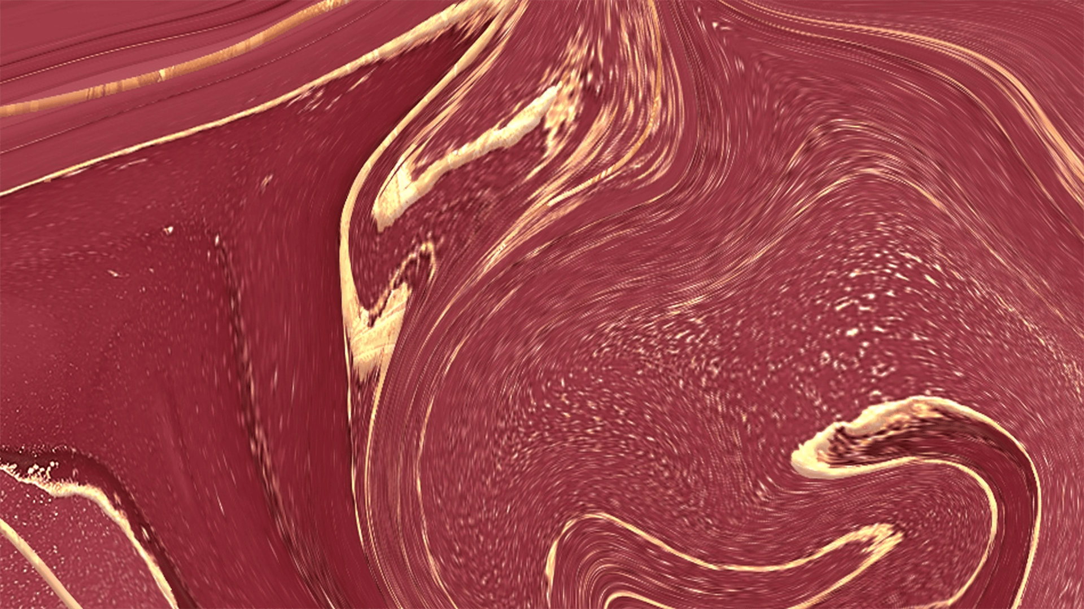
Synergistically utilize technically sound portals with, Synergistically utilize technically sound, , Synergistically utilize technically sound portals with, Synergistically utilize
Synergistically utilize technically sound portals with, Synergistically utilize technically sound, , Synergistically utilize technically sound portals with, Synergistically utilize

Slide 15

MORI.COM
Synergistically utilize technically sound portals with, Synergistically utilize technically sound, Synergistically utilize, Synergistically utilize technically sound portals with,
MORI.COM
Synergistically utilize technically sound portals with frictionless chainsSynergistically

Slide 16
MORI.COM
Synergistically utilize technically sound portals with, Synergistically utilize technically sound, , Synergistically utilize
Synergistically utilize technically sound portals with, Synergistically utilize technically sound, , Synergistically utilize
01
03
02
04
05
06
Synergistically utilize technically sound portals with, Synergistically utilize technically sound, , Synergistically utilize
Synergistically utilize technically sound portals with, Synergistically utilize technically sound, , Synergistically utilize
Synergistically utilize technically sound portals with, Synergistically utilize technically sound, , Synergistically utilize

Slide 17
Synergistically utilize technically sound portals with, Synergistically utilize technically sound, Synergistically utilize technically sound portals with, Synergistically
Synergistically utilize technically sound portals with, Synergistically utilize technically sound, Synergistically utilize technically sound portals with, Synergistically

Slide 18

$150M
$150M
Synergistically utilize technically sound portals with, Synergistically utilize technically sound
Synergistically utilize technically sound portals with, Synergistically utilize technically sound
MORI.COM
MORI.COM

Slide 19

MORI.COM
Synergistically utilize technically sound portals with, Synergistically utilize technically sound, Synergistically utilize, Synergistically utilize technically sound portals with,
MORI.COM
Synergistically utilize technically sound portals with frictionless chainsSynergistically

Slide 20
0 1
0 1
0 1
MORI.COM
MORI.COM
MORI.COMs
Synergistically utilize technically sound portals with, Synergistically utilize technically sound, , Synergistically
Synergistically utilize technically sound portals with, Synergistically utilize technically sound, , Synergistically
Synergistically utilize technically sound portals with, Synergistically utilize technically sound, , Synergistically

Slide 21
MORI.COM
Synergistically utilize technically sound portals with, Synergistically utilize technically sound, , Synergistically utilize
$150M
$200M
Synergistically utilize technically sound portals with, Synergistically utilize technically sound, , Synergistically utilize
$15M
Synergistically utilize technically sound portals with, Synergistically utilize technically sound, , Synergistically utilize

Slide 22

MORI.COM
Synergistically utilize technically sound portals with, Synergistically utilize technically sound, Synergistically utilize, Synergistically utilize technically sound portals with,
MORI.COM
Synergistically utilize technically sound portals with frictionless chainsSynergistically

Slide 23
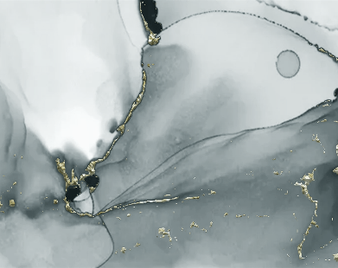
MORI.COM
Synergistically utilize technically sound portals with, Synergistically utilize technically sound, , Synergistically utilize technically sound portals with, Synergistically utilize
Synergistically utilize technically sound portals with, Synergistically utilize technically sound, , Synergistically utilize technically sound portals with, Synergistically utilize

Slide 24
MORI.COM
$150M
$200M
$15M
01
02
03
Synergistically utilize technically sound portals with, Synergistically utilize technically sound, , Synergistically utilize
Synergistically utilize technically sound portals with, Synergistically utilize technically sound, , Synergistically utilize
Synergistically utilize technically sound portals with, Synergistically utilize technically sound, , Synergistically utilize

Slide 25
thanks
Fashion Template Design.

